Slide 1


Modern HTML5 Game Development With
Phaser.JS & TypeScript
Phaser.JS is a robust mobile and desktop game framework, distributed under the MIT open source licence, based on HTML5 Canvas and WebGL technologies that allow you to build once and deploy across all modern web enabled devices. This presentation goes over the basic workflow of getting up and running with Phaser.JS by presenting a simple game designed for this presentation. Even if you are not interested in making games, this platform is great for any applications that require complex user interactions.
Presented By: Andrew Ribeiro | Git: Andrewnetwork

Slide 2
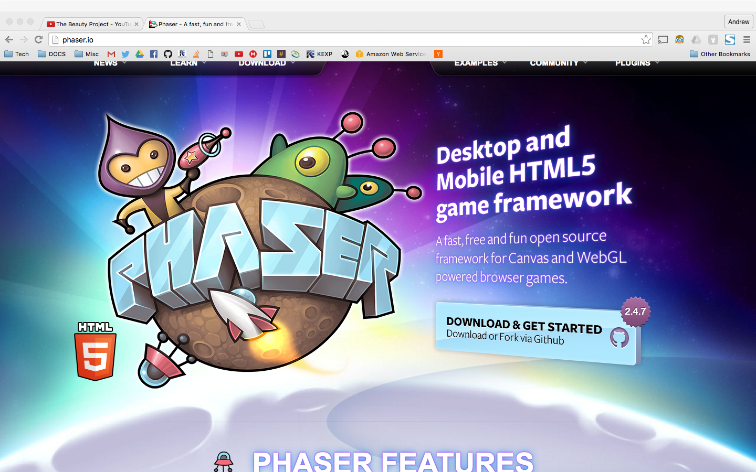

Slide 3
PROLOGUE
OPINION?
REALITY?
Flash is a mess, Flash is a waste, Flash is a big fat mistake.
ADOBE FLASH KILLED THE INTERNET
Introduced several vulnerabilities
Decreased performance
Acceptance of plugins
Proprietary
A terror for early smartphones
Savior: HTML5
No plugins!
All application functionality is provided by the browser.
Complete web applications platform.
Phaser brings out the power of the HTML5 stack for applications previously done not natively in the browser ( through plugins ).
WANTED
DEAD

Slide 4



What you need to know------------------Prerequisites
Like any subject, you can tackle anything if you have the passion for it.
Essential To Know:
JavaScript or TypeScript( If you wish to use it )
Object Oriented Design
Good to Know:
Basics of Game Development
HTML5 Features.
A server side language/platform for data processing. ( PHP, ASP.NET, Node.js )

Slide 5
What we’re covering ----------------------- overview
Prologue ✓
Prerequisites ✓
TypeScript and JavaScript
About Phaser
Examples
Features
Pixi.js
Physics
Phaser Phases
preload,create,update, & render
Simple Example: Castlevania Loader
Advanced Example: TankGame
OpenGl
Deployment
Intel XDK
Cordova
AWS
Resources
TypeScript
3D Game Development
Phaser Examples
Misc
Questions & Comments

Slide 6

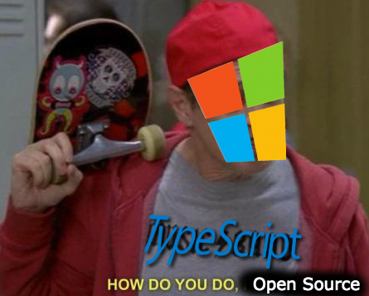
JavaScript &
Open source strict superset of JavaScript developed and maintained by Microsoft.
Adds optional static typing and class-based object-oriented programming to the language.
( First version: October 1, 2012, Current: 1.8 / January 2016 )
TypeScript supports definition files.
This enables other programs to use the values defined in the files as if they were statically typed TypeScript entities
There are definition files for Phaser and Pixi.js
TypeScript is transcompiled to JavaScript.
Nice compile time type checking.
Free IDE: http://typecsdev.com/
Notes:
ASK: How many of you are familiar with typescript? Javascript? | If most are familiar skip.

Slide 7
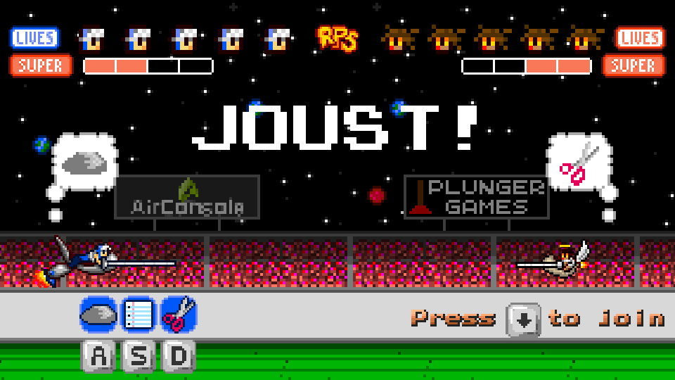
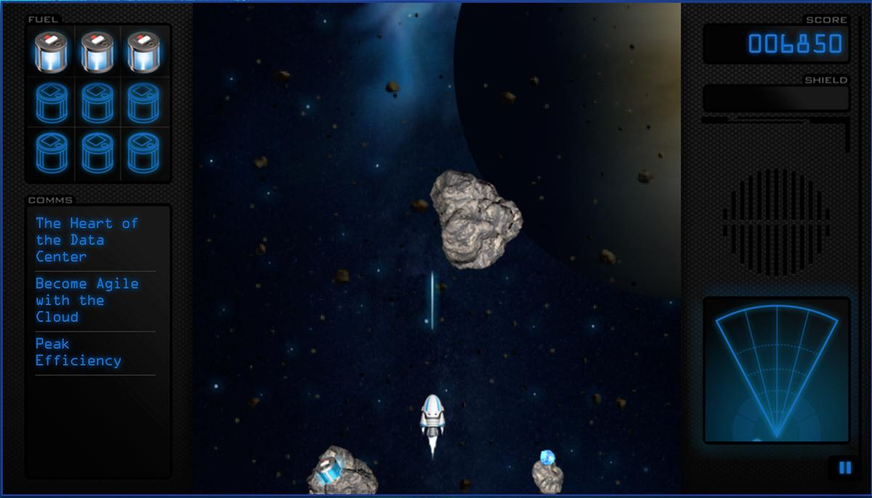
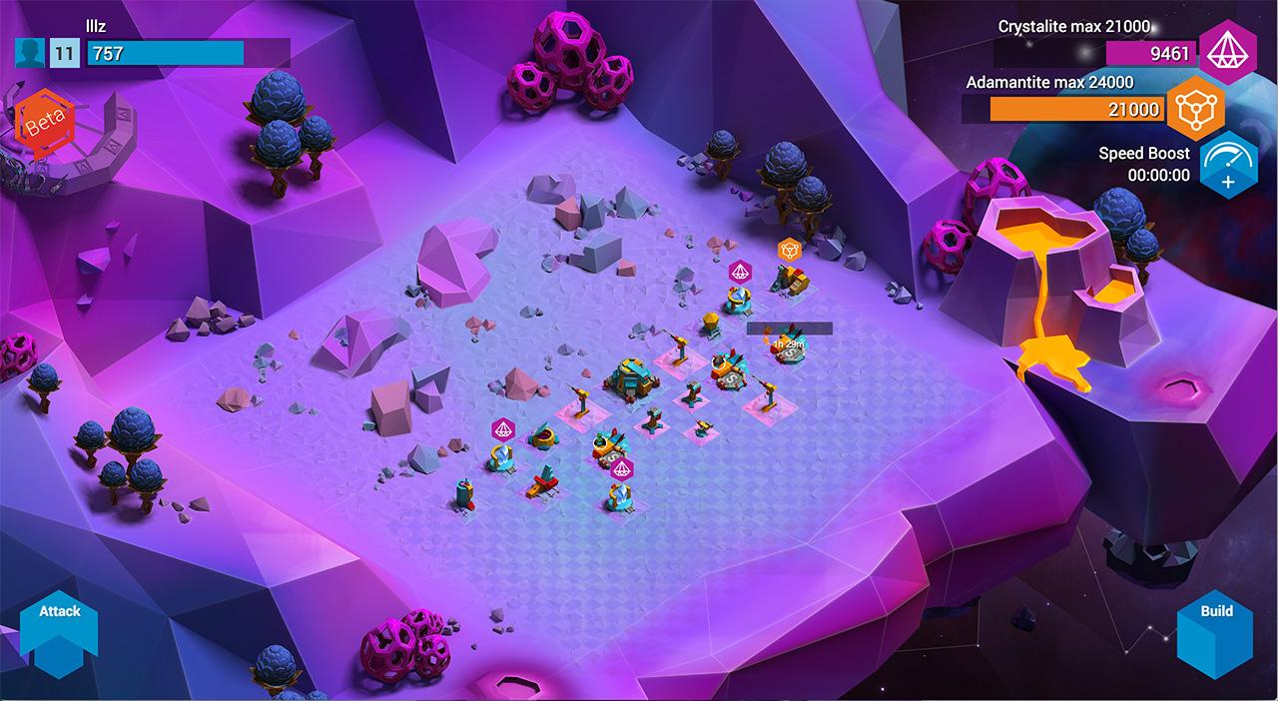
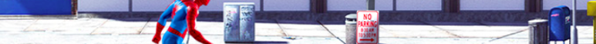

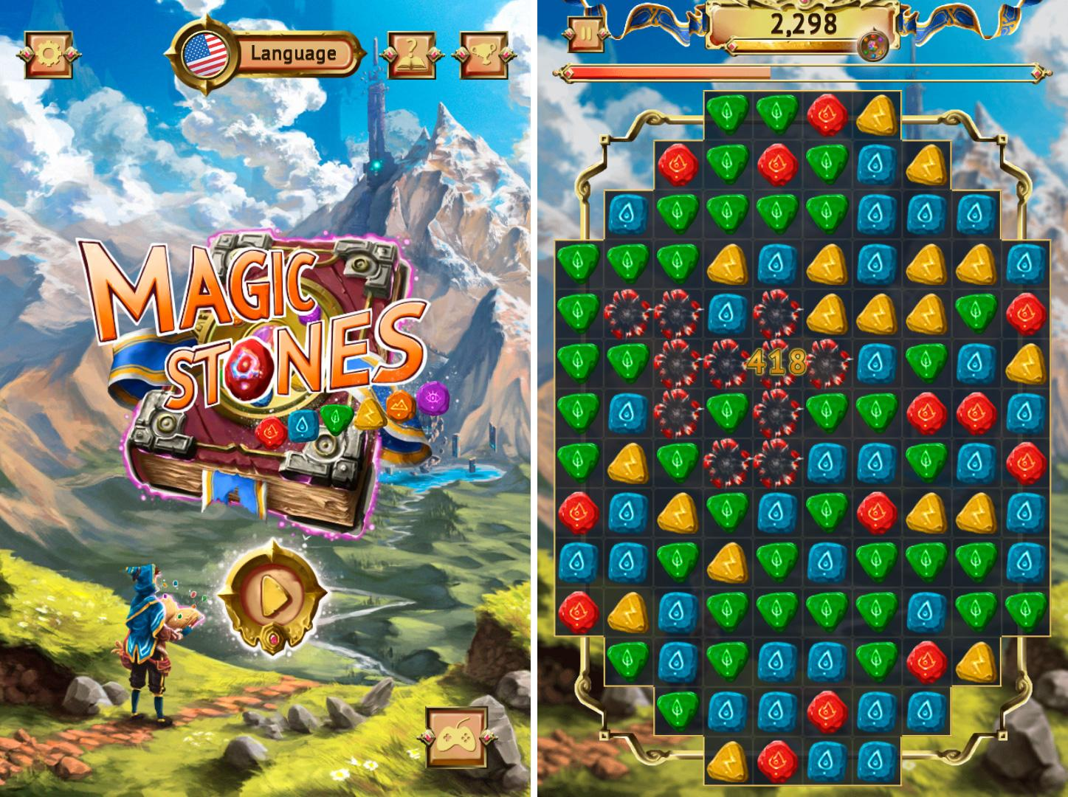

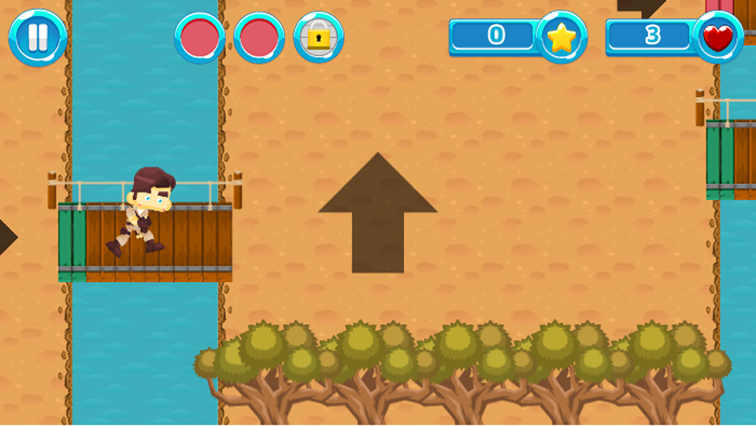
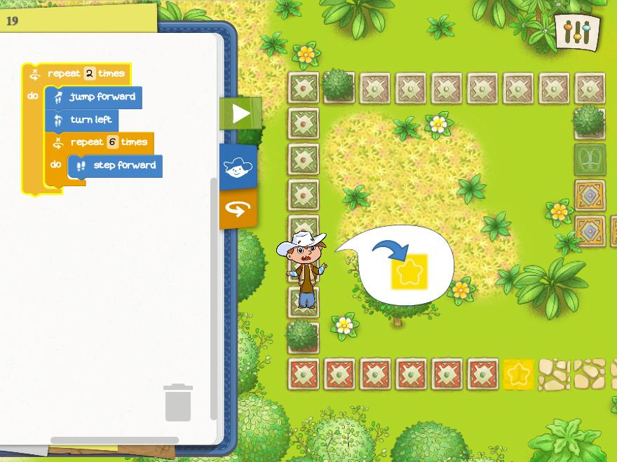
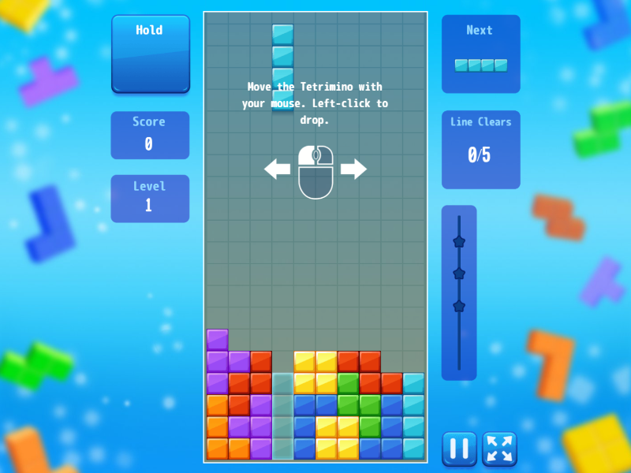
What is PhaserJS?
Open source HTML5 game framework useful for developing cross platform 2D games or complex user interfaces for the web.
What phaser is not:
Not a 3D game engine.
Use BabylonJS
Does not support VR.
Not a standalone application.
Open Source Licence: MIT.

Slide 8
Phaser Features.................................................................1
Cross Platform WebGL and Canvas Rendering ( Pixi.js )
Simple Asset Preloading
Built in Physics Support
Sprites: tweens, movement, translation, collision, textures, responsive input, pixel perfect click detection.
Groups: grouping of sprites for pooling, recycling, and collision with custom callbacks.
Animation: sprite sheets, texture packing, JSON data.
Particles: easily create particle effects like explosions, constant streams like rain or fire.
Notes:
An object pool is a collection of a particular object that an application will create and keep on hand for those situations where creating each instance is expensive. A good example would be a database connection or a worker thread. The pool checks instances in and out for users like books out of a library.
Particles: An Arcade Particle system is built-in, which allows you to create fun particle effects easily. Create explosions or constant streams for effects like rain or fire. Or attach the Emitter to a Sprite for a jet trail.

Slide 9
Phaser Features.................................................................2
Camera: pan around and follow sprites in the built in game world easily.
Input: Multi-touch, mouse, keyboard support. Robust input management system.
Sound: Web Audio and legacy HTML Audio support. Simplifies dealing with mobile audio.
Tile Maps: CSV and Tiled-map data formats. Powerful tile manipulation: swap tiles, replace, delete, and update maps in realtime.
Device Scaling: allows you to scale your game to fit any size screen. Control aspect ratios, minimum and maximum scales and full-screen support.

Slide 10
Useful HTML5 Features
Connectivity
Web Sockets
Sever-sent events ( server can push events to client without request)
WebRTC
Offline & Storage
Application Cache
Web Storage
Indexed Database API
File API
Offline and Online Events
Performance & Misc
Web Workers
Fullscreen API
Pointer Lock API
Orientation Detection

Slide 11
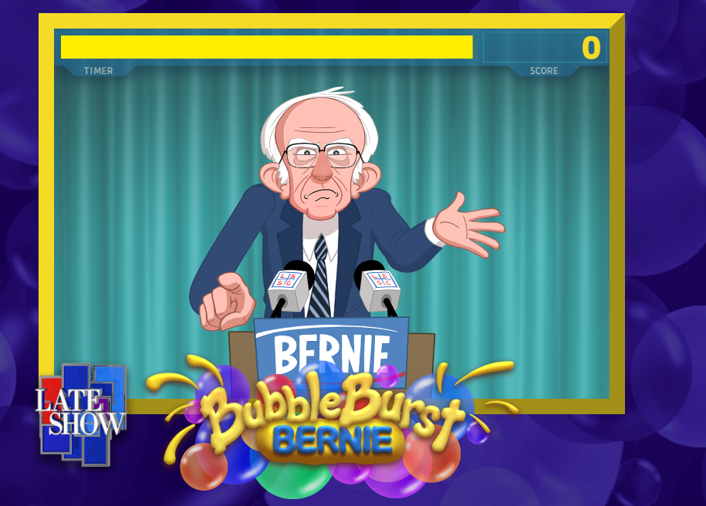
Phaser Examples................................................Be creative!
Bubble Burst Bernie
Game URL:
http://www.cbs.com/shows/the-late-show-with-stephen-colbert/bubble-burst-bernie/
Colbert Segment :
https://www.youtube.com/watch?v=aMTGpcASAHw

Slide 12
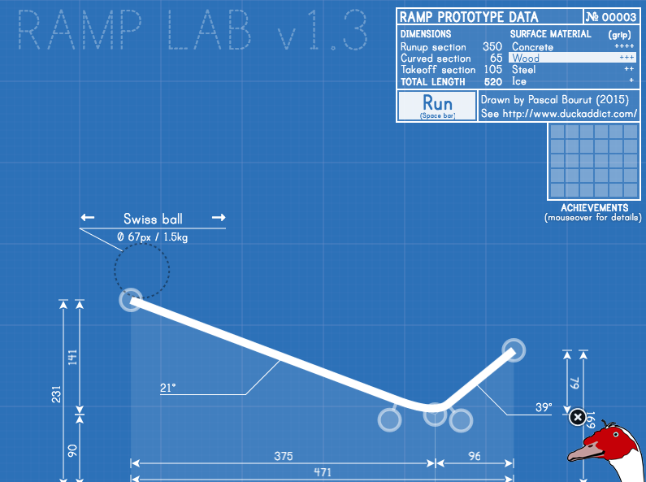
Phaser Examples................................................Be creative!
Ramp Lab 1.3
Physics Simulation
Game URL:
http://www.kongregate.com/games/toweld/ramp-lab

Slide 13
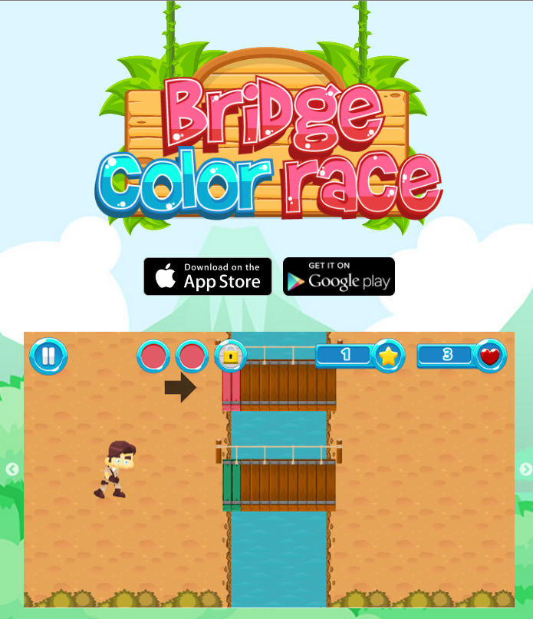
Phaser Examples................................................Be creative!
Bridge Color Race
Mobile Game
Game URL:
http://www.bridgecolorrace.com/

Slide 14
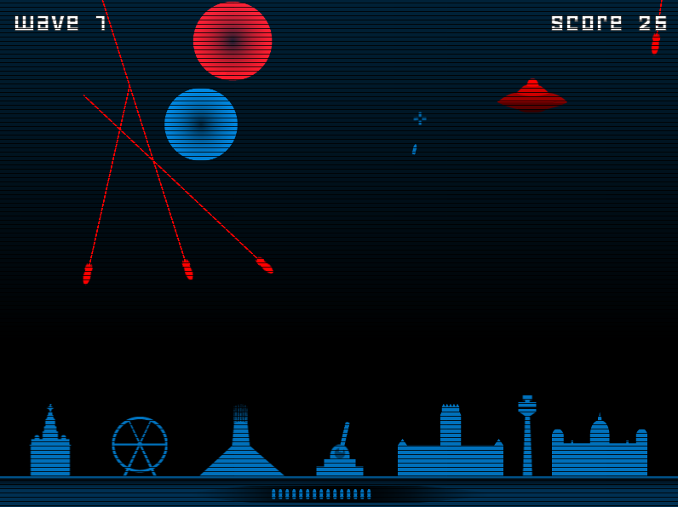
Phaser Examples................................................Be creative!
Rival Command
TypeScript Tutorial:
https://www.digi-dom.co.uk/rival-command-a-game-built-with-phaser-js/
Game URL:
https://www.digi-dom.co.uk/games/rival-command/

Slide 15
Pixi.js..................................................PhaserJS Rendering
Multi-Platform 2D webGL renderer with canvas fallback.
Seamless canvas fallback means that you really can author once, and then deploy everywhere – in browser.
Multi-touch support.
WebGL filters.
Tinting and Blend Modes
Sprite Sheets
Scene Graph
Hierarchical arrangement of items.
The backed of PhaserJS.

Slide 16
Physics Engines
Arcade Physics
An extremely light-weight AABB(collision detection) library perfect for low-powered devices.
Ninja Physics
Ninja Physics. The Ninja Physics system was created in Flash by Metanet Software and ported to JavaScript by Richard Davey. It allows for AABB and Circle to Tile collision. Tiles can be any of 34 different types, including slopes, convex and concave shapes.
P2.js
A full-body system with springs, constraints and advanced polygon support.
Box2D
Available as a premium plug-in, but there are free sources.
Notes:
AABB: (Axis Aligned Bounding Box)

Slide 17
Phaser Phases..........................................................preload
preload() is called first. Normally you'd use this to load your game assets (or those needed for the current State) You shouldn't create any objects in this method that require assets that you're also loading in this method, as they won't yet be available.
Notes:
An object pool is a collection of a particular object that an application will create and keep on hand for those situations where creating each instance is expensive. A good example would be a database connection or a worker thread. The pool checks instances in and out for users like books out of a library.
Particles: An Arcade Particle system is built-in, which allows you to create fun particle effects easily. Create explosions or constant streams for effects like rain or fire. Or attach the Emitter to a Sprite for a jet trail.

Slide 18
Phaser Phases............................................................CREATE
The constructor for the game state.
create() is called once preload has completed, this includes the loading of any assets from the Loader. If you don't have a preload method then create is the first method called in your State.
Notes:
An object pool is a collection of a particular object that an application will create and keep on hand for those situations where creating each instance is expensive. A good example would be a database connection or a worker thread. The pool checks instances in and out for users like books out of a library.
Particles: An Arcade Particle system is built-in, which allows you to create fun particle effects easily. Create explosions or constant streams for effects like rain or fire. Or attach the Emitter to a Sprite for a jet trail.

Slide 19
Phaser Phases.............................................UPDATE & Render
State.render()
Called once per requestAnimationFrame.
Nearly all display objects in Phaser render automatically, you don't need to tell them to render. However the render method is called AFTER the game renderer and plugins have rendered, so you're able to do any final post-processing style effects here. Note that this happens before plugins postRender takes place.
State.update()
Called game.time.desiredFps times per second (desiredFps is 60 by default).
Called during the core game loop AFTER debug, physics, plugins and the Stage have had their preUpdate methods called. Called BEFORE Stage, Tweens, Sounds, Input, Physics, Particles and Plugins have had their postUpdate methods called.
You can typically put all your update code in the update() function, but you will want to investigate if you can place it in render() as your game grows larger.
Notes:
An object pool is a collection of a particular object that an application will create and keep on hand for those situations where creating each instance is expensive. A good example would be a database connection or a worker thread. The pool checks instances in and out for users like books out of a library.
Particles: An Arcade Particle system is built-in, which allows you to create fun particle effects easily. Create explosions or constant streams for effects like rain or fire. Or attach the Emitter to a Sprite for a jet trail.

Slide 20
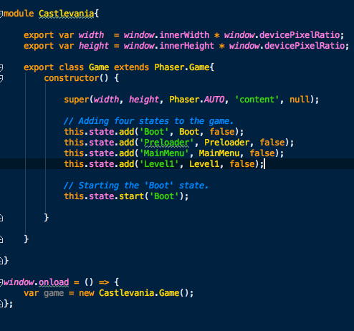
Simple Example: Castlevania Loader..........................States
We can create modular game elements by using states.
Castlevania Loader States
Boot
Preloader
Main Menu
Level1
We start the game by starting the
Each state has its own phases.
Boot state.
Code: Basics/AdvancedPhaserSetup
Notes:
add : Phaser.GameObjectFactory

Slide 21
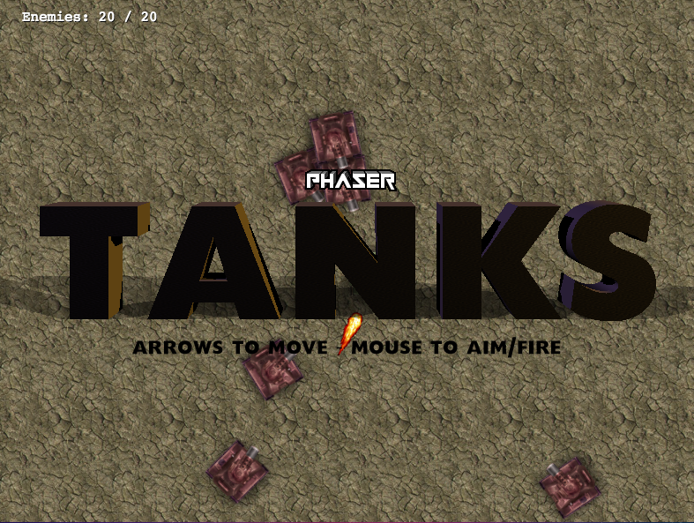
TankGame......................................................in typescript
Look at the Code
Uses arcade physics
Port of the JS EX
Code: TankGame
Notes:
AABB: (Axis Aligned Bounding Box)

Slide 22

WebGl Filters
Phaser’s rendering engine, Pixi.JS, supports OpenGl shaders.
Phaser an Pixi calls shaders “filters.”
See the built-in filters here: http://www.goodboydigital.com/pixijs-webgl-filters/
WebGL support is the reason I’ve labeled this talk “Modern.”
They are also stackable and nestable so a sprite can have multiple webGL filters attached to it with another sprite inside it with multiple webGL filters on that.
See example: WebGL/Shaders_Filters/WebGL_PlaneDeformation/

Slide 23
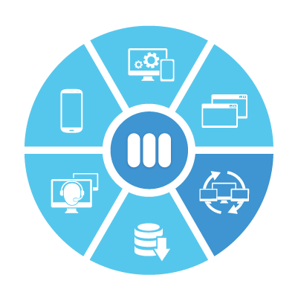
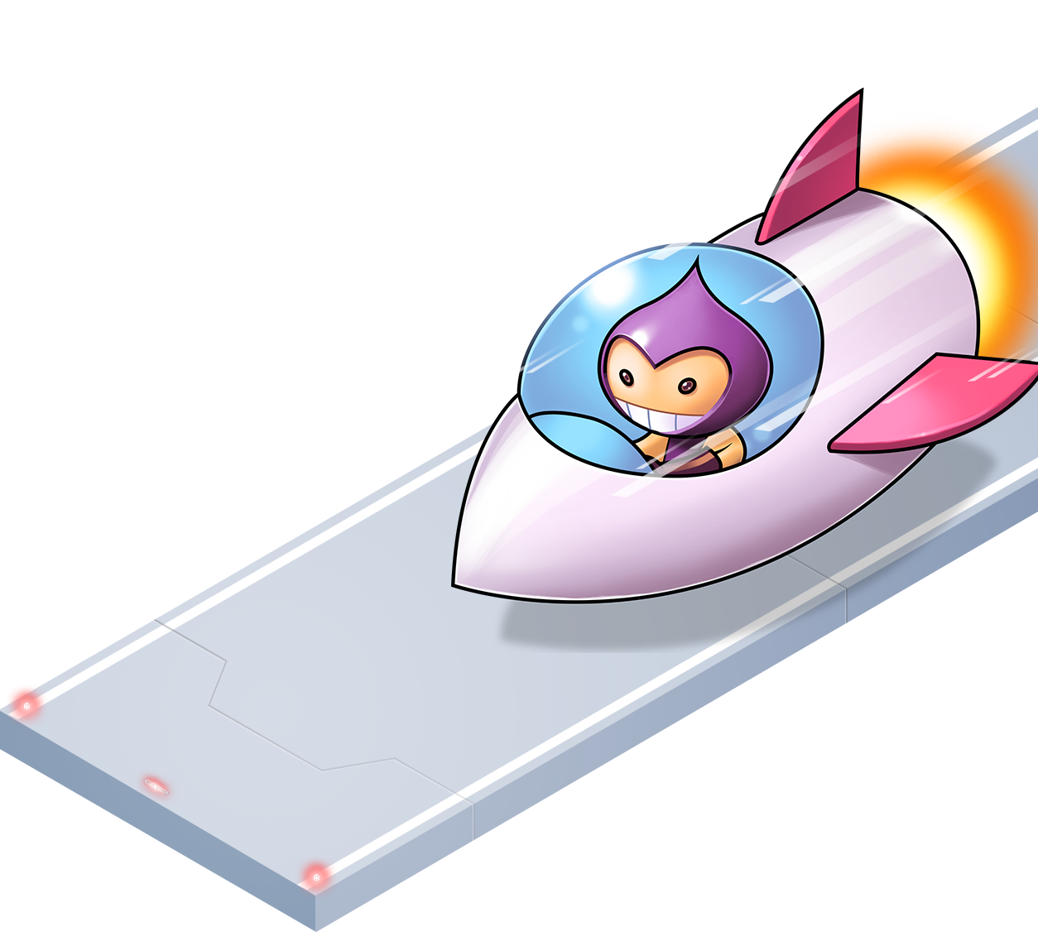
PHASER
Deployment

Slide 24
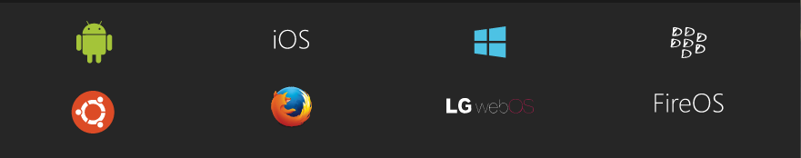
Cordova
Cordova wraps your HTML/JavaScript app into a native container which can access the device functions of several platforms. These functions are exposed via a unified JavaScript API, allowing you to easily write one set of code to target nearly every phone or tablet on the market today and publish to their app stores.

Slide 25
Intel XDK..........................................................................1
All-in-one development environment to easily simulate, test, tune, and deploy games to many app stores using one code base.
Game engine support for Construct2, Cocos2D, Phaser, Pixi.js*, and Easel.JS to easily import assets and code.
The Intel XDK Game Asset Manager provides a central place to view game assets, including viewing animation (if any) and details. The Game Asset Manager also generates a code snippet for each selected asset that you can use to help you develop your HTML5/JavaScript/CSS game sources.

Slide 26
Intel XDK..........................................................................2
Google Play Game Services and Apple Game Center services support to drive engagement, socialize, and reward players.
W3C Gamepad API support enables high-impact game interaction using gamepad or joystick devices
Apache Cordova plugins and APIs to monetize and market action-packed multi-OS games
Works with Cordova
“Easy Path to HTML5 App Development, Fast Path to Multi-OS App Stores”

Slide 27
Aws,Heroku,Web Servers..................Where to put your stuff
What do you use to host your web applications?

Slide 28
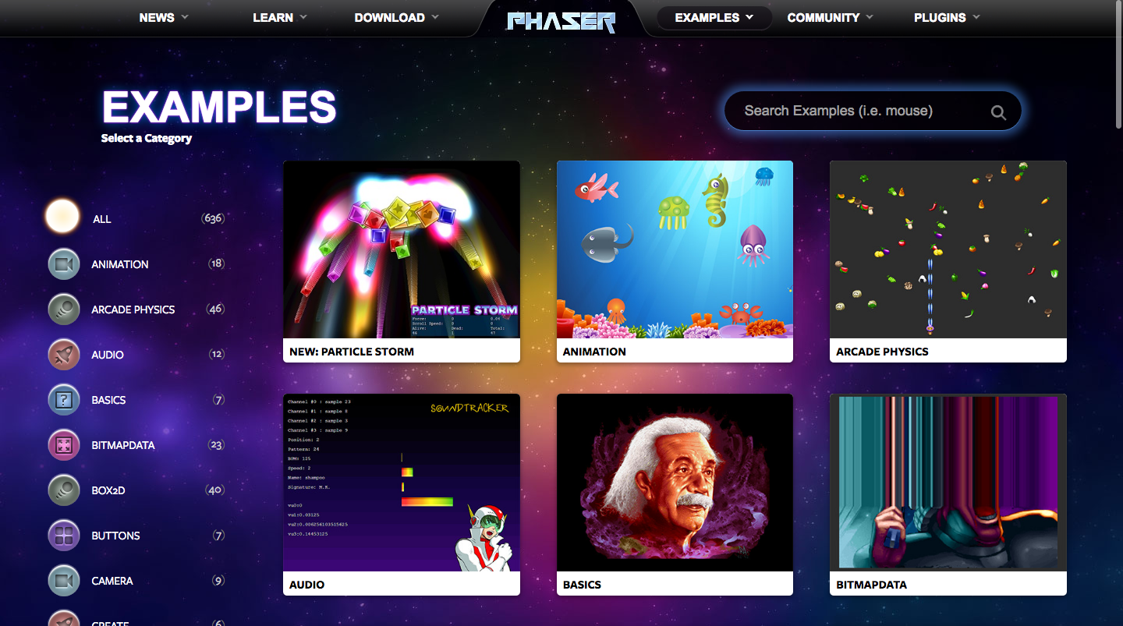
http://phaser.io/examples
RESOURCE
Really awesome categorized source code examples.

Slide 29
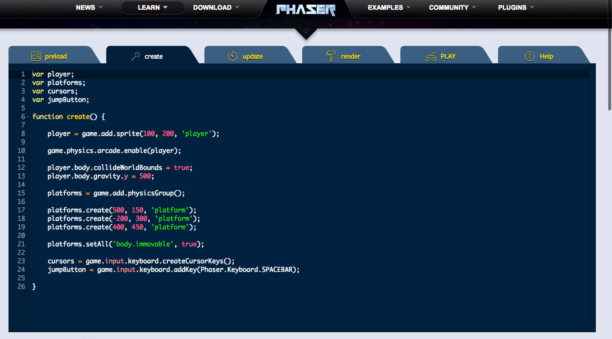
http://phaser.io/sandbox
RESOURCE
An online sandbox for running phaser code.

Slide 30
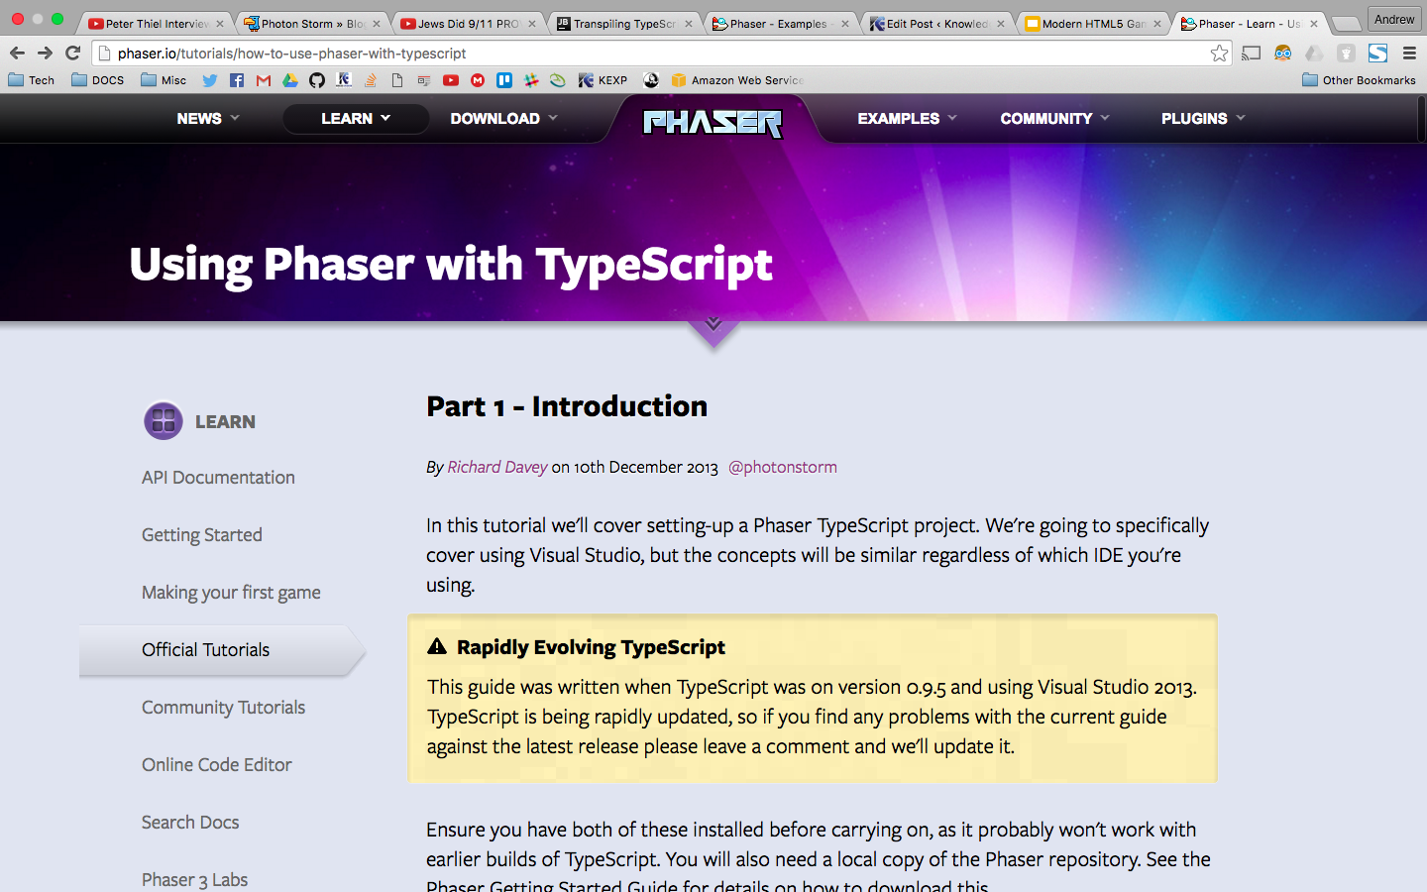
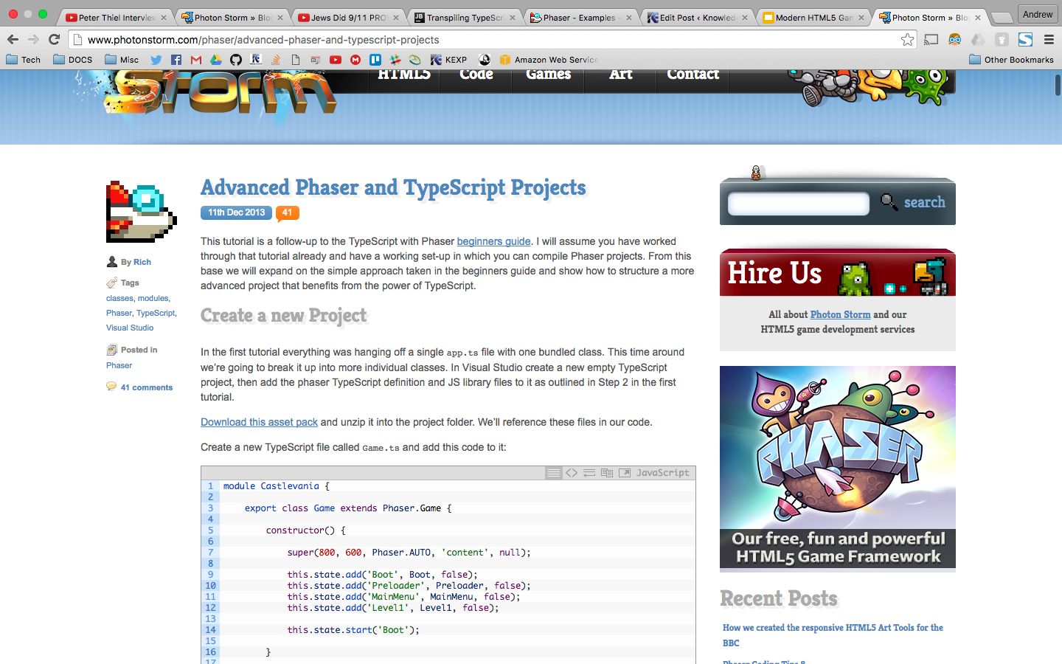
Phaser TypeScript Tutorials
RESOURCE
http://phaser.io/tutorials/how-to-use-phaser-with-typescript
http://www.photonstorm.com/phaser/advanced-phaser-and-typescript-projects
Part 1
Part 2

Slide 31
Misc Resources (1)
RESOURCE
Name | URL | Note
AABB | https://www.youtube.com/watch?v=ghqD3e37R7E | Collision Detection
p2.js | https://github.com/schteppe/p2.js/wiki | Advanced Physics 2D Lib
Physics Sys Compared | http://www.html5gamedevs.com/topic/4518-explaining-phaser-2s-multiple-physics-systems/ | Which physics system should I use?
Arcade Physics | http://phaser.io/examples/v2/category/arcade-physics | Basic Physics
Particles | http://phaser.io/examples/v2/category/particles | Particle Examples
BabylonJS | http://www.babylonjs.com/ | HTML5 3D Game Dev

Slide 32
Misc Resources (2)
RESOURCE
Name | URL | Note
ThreeJS | http://threejs.org/ | 3D WebGL Renderer
OpenGL Sandbox | http://glslsandbox.com/ | Different OpenGL shaders you can repurpose for use in your game.
ShaderToy | https://www.shadertoy.com/ | More code for OpenGL shaders.
TLDR Legal | https://tldrlegal.com/license/mit-license | Understand the licence this software is distributed under.
Udacity HTML5 | https://www.udacity.com/course/html5-game-development--cs255 | A free HTML5 game development course taught by google.

Slide 33

Misc Resources (3)
RESOURCE
Name | URL | Note
ZebraJS | http://www.zebkit.com/ | Canvas UI
Box2D JS | http://box2d-js.sourceforge.net/index2.html | JS version of Box2D.
TypeScript | https://en.wikipedia.org/wiki/TypeScript | A history of TypeScript
EZGUI | https://github.com/Ezelia/EZGUI | A UI framework that’s made for phaser.
HTML5 Game Dev Forums | http://www.html5gamedevs.com/ | Great forum for different html5 frameworks.
Phaser Mobile | https://hacks.mozilla.org/2015/12/from-game-jam-to-mobile-and-firefox-os/ | Notes on how to make a Phaser game across multiple platforms.

Slide 34
Misc Resources (4)
RESOURCE
Name | URL | Note
Cordova + Phaser Tutorial | https://software.intel.com/en-us/html5/hub/blogs/how-to-make-a-mobile-virtual-pet-game-with-html5-and-cordova/ | How to use the cordova api with phaser to make mobile apps.
Cordova | https://cordova.apache.org/ | Formerly phonegap.

Slide 35


QUESTIONS& COMMMENTS
Presented By: Andrew Ribeiro
AndrewRIB.com
AndrewNetwork@gmail.com
FIND THIS PRESENTATION ONLINE:
https://github.com/Andrewnetwork/PhaserPresentation2016

